Slide 1
Machine Learning

Slide 2


CSD AI & Machine Learning Lesson 2 - Activity
Mental Model
Machine Learning
Model

Slide 3
AI VS ML
AI (Artificial Intelligence): machines or computers simulating human intelligence, such as learning, problem-solving, and decision-making.
ML (Machine Learning): is a subset of artificial intelligence that automatically enables a machine or system to learn and improve from experience

Slide 4

CSD AI & Machine Learning Lesson 2 - Activity
Key Vocabulary
Model - a computer program designed
to make a decision

Slide 5
CSD AI & Machine Learning Lesson 2 - Activity
Types of Machine Learning
Activity 1:
Read the following 4 paragraphs, and group similar paragraphs together

Slide 6
Paragraph A
To many, Messi leading his country of Argentina to a World Cup is like a prerequisite for him to be regarded as the greatest. To some, Messi is called the best club footballer ever but hold the right to reserve the Best Ever talks until he holds that beautiful, shinny golden trophy in his hands.

Slide 7
Paragraph B
Good recipe but needs lime juice (to be authentic) instead of lemon juice and a clove of crushed garlic. Tomato is optional, guacamole keeps better without the tomato. Also chopped jarred jalapeno works if a fresh pepper isn't on hand.

Slide 8
Paragraph C
Messi has always had the most intense spotlight shone on him at World Cup finals. He has featured in four World Cups and this will be his fifth (and potentially last), which will see him become the first Argentinian player to do so. Scoring at every World Cup except the 2010, he's scored six goals and provided five assists in 19 appearances, and hopes to add to that record in Qatar.

Slide 9
Paragraph D
We love guacamole and this is a good recipe, but definitely use lime juice and add some garlic. A tip to keep your guacamole from turning brown is to put the avocado pits back into the guac until you are ready to serve.

Slide 10
CSD AI & Machine Learning Lesson 2 - Activity
Think
What groupings did you create? Is there a pattern?

Slide 11

CSD AI & Machine Learning Lesson 2 - Activity
Key Vocabulary
Unsupervised Learning - finding patterns in data that doesn’t have any labels
Features - the inputs that the model uses to make decisions
223
185
124
64

Slide 12
CSD AI & Machine Learning Lesson 2 - Activity
Types of Machine Learning
Activity 2:
Classify the words into the corresponding categories
Sentence 1: To many, Messi leading his country of Argentina to a World Cup is like a prerequisite for him to be regarded as the greatest.
Sentence 2: Dr. Dan Shechtman (2011 Nobel Prize in Chemistry): A materials scientist at ISU and the Ames National Laboratory, he was awarded the prize "for the discovery of quasicrystals."
Now, which word(s) should be highlighted in the following sentence?
Students line up to ask Brock Purdy questions during a communication studies class in early November.

Slide 13
CSD AI & Machine Learning Lesson 2 - Activity
Key Vocabulary
Supervised Learning - When a human trains a model to learn with examples.

Slide 14
CSD AI & Machine Learning Lesson 2 - Activity
Key Vocabulary
Training - the process of giving examples to a model so it can learn
Testing - the process of giving a new example to a model to predict

Slide 15
CSD AI & Machine Learning Lesson 2 - Activity
Key Vocabulary
Label - the output you are trying to decide or predict with a model. It is also the outcomes that the model learns to associate with the input features during training.

Slide 16
CSD AI & Machine Learning Lesson 2 - Activity
Key Vocabulary
Classification - task of predicting a discrete class label for an example.
Regression - task of predicting a continuous quantity for an example.

Slide 17
CSD AI & Machine Learning Lesson 2 - Activity
Key Vocabulary
Loss - Loss in machine learning is a numerical metric that quantifies how far a model's predictions deviate from the actual true values (ground truth).

Slide 18
Summary
Supervised learning
Supervision: The training data such as observations or measurements are accompanied by labels indicating the classes which they belong to
New data is classified based on the models built from the training set
Training Data with class label:
Model
Learning
Outlook | Temp | Humidity | Windy | Play Golf
Rainy | Hot | High | False | No
Rainy | Hot | High | True | No
Overcast | Hot | High | False | Yes
Sunny | Mild | High | False | Yes
Sunny | Cool | Normal | False | Yes
Sunny | Cool | Normal | True | No
Overcast | Cool | Normal | True | Yes
Rainy | Mild | High | False | No
Training
Instances
Positive
Prediction
Model
Test
Instances
Negative

Slide 19
Summary
Unsupervised learning (clustering)
The class labels of training data are unknown
Given a set of observations or measurements, establish the possible existence of classes or clusters in the data

Slide 20
Summary
Classification
Predict categorical class labels (discrete or nominal)
Construct a model based on the training set and the class labels (the values in a classifying attribute) and use it in classifying new data
Regression (Numeric prediction)
Model continuous-valued functions (i.e., predict unknown or missing values)
outlook?
Sunny
Overcast
Rainy
windy?
Yes
Humidity?
False
True
Normal
High
Yes
No
Yes
No

Slide 21
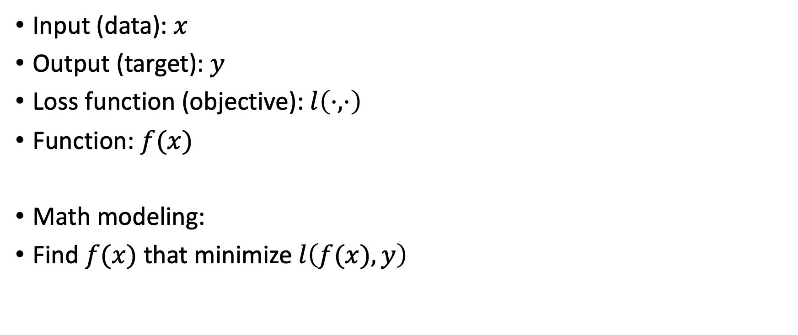
Mathematical recipe
Input (data): $x$
Output (target): $y$
Loss function (objective): $l\left(⋅,⋅\right)$
Function: $f(x)$
Math modeling:
Find $f(x)$ that minimize $l\left(f(x),y\right)$

Slide 22
How to train AI to see and to write
https://youtu.be/y2BVTW09vck
https://www.youtube.com/watch?v=d2UccTPnl4w&t=1s

Slide 23
CSD AI & Machine Learning Lesson 2 - Activity
Key Vocabulary
Generative – models that can generate new data instances
Discriminative – models that discriminate between different kinds of data instances

Slide 24
CSD AI & Machine Learning Lesson 2 - Activity
Generative or Discriminative? (or both?)
Language Translation
Face recognition
Function prediction

Slide 25
Generative vs. Discriminative Classifiers
X: observed variables (features)
Y: target variables (class labels)
A generative classifier models p(Y, X)
It models how the data was "generated“, "what is the likelihood this or that class generated this instance?" and pick the one with higher probability
A discriminative classifier models p(Y|X)
It uses the data to create a decision boundary

Slide 26
Relationships Among Different Kinds of Supervisions
Courtesy: A Ratner et al. @Stanford Blog, July 2017

Slide 27
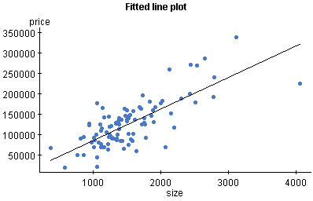
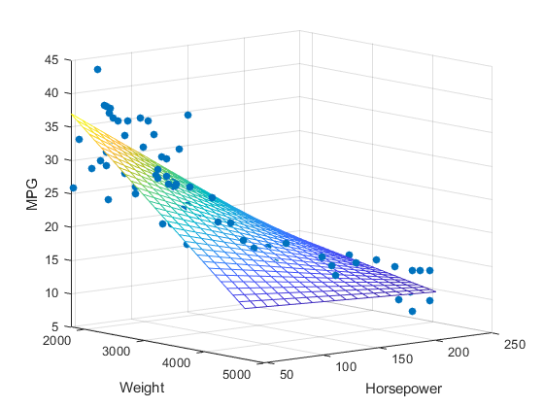
Linear Regression Problem: Example
Mapping from independent attributes to continuous value: x => y
{living area} => Price of the house
{college; major; GPA} => Future Income
Price of houses
Living Area

Slide 28
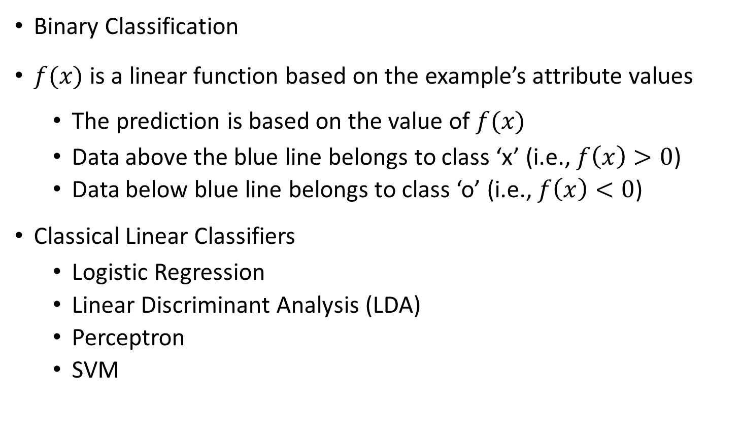

Linear Classifier: General Ideas
Binary Classification
$f(x)$ is a linear function based on the example’s attribute values
The prediction is based on the value of $f(x)$
Data above the blue line belongs to class ‘x’ (i.e., $f\left(x\right)>0$)
Data below blue line belongs to class ‘o’ (i.e., $f\left(x\right)<0$)
Classical Linear Classifiers
Logistic Regression
Linear Discriminant Analysis (LDA)
Perceptron
SVM
x
x
x
x
x
x
x
x
x
o
o
x
o
o
o
o
o
o
o
o
o
o
o

Slide 29
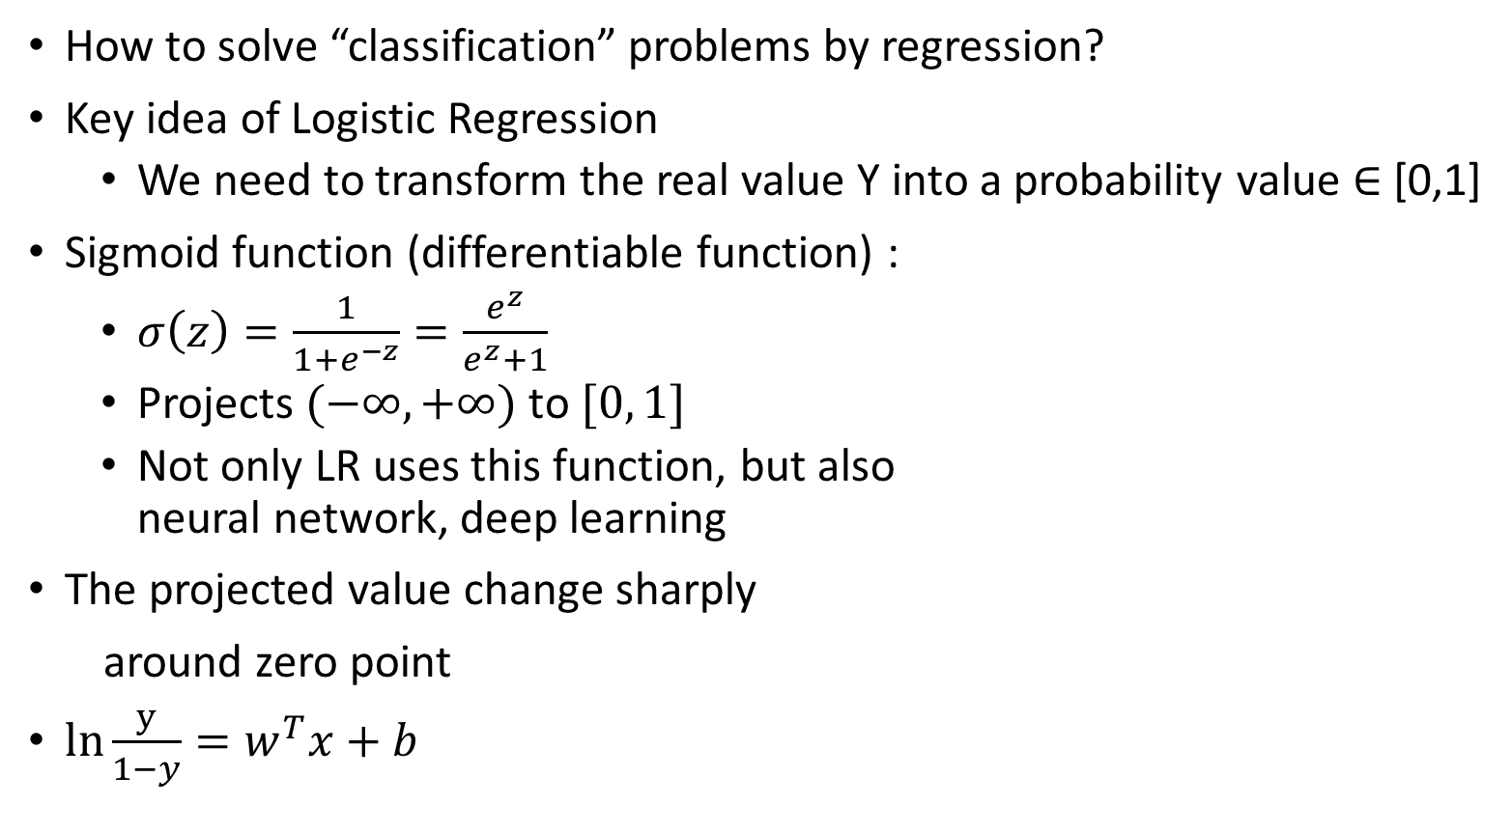
Logistic Regression: General Ideas
How to solve “classification” problems by regression?
Key idea of Logistic Regression
We need to transform the real value Y into a probability value $∈$ [0,1]
Sigmoid function (differentiable function) :
$σ\left(z\right)=\frac{1}{1+e^{−z}}=\frac{e^{z}}{e^{z}+1}$
Projects $(−∞, +∞)$ to $[0, 1]$
Not only LR uses this function, but also neural network, deep learning
The projected value change sharply
around zero point
$ln\frac{y}{1−y}=w^{T}x+b$
Sigmoid
Function

Slide 30
Logistic Regression: An Example
Suppose we only consider the year as feature
Data points are converted by sigmoid function (“activation” function)
1 (graduate)
year
4

Slide 31
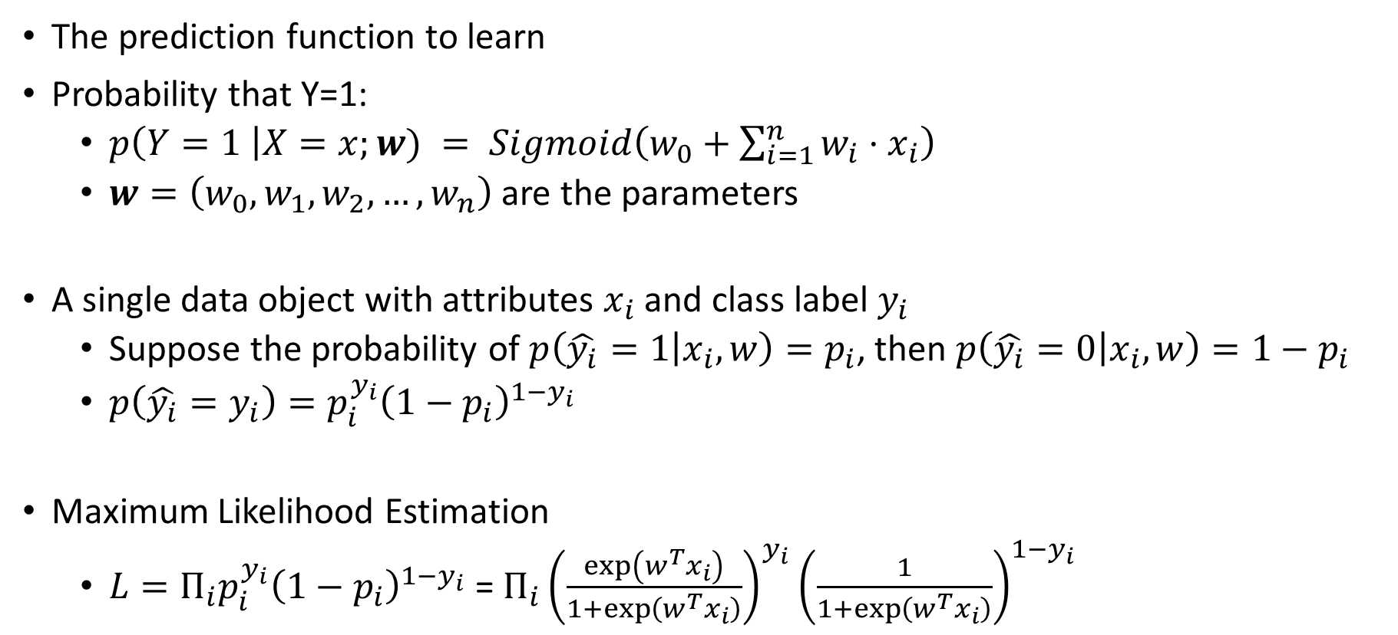
Logistic Regression: Model
The prediction function to learn
Probability that Y=1:
$p\left(Y=1 \right|X=x;w) = Sigmoid\left(w_{0}+\sum_{i=1}^{n}{w_{i}⋅x_{i}}\right)$
$w=\left(w_{0}, w_{1}, w_{2},…,w_{n}\right)$ are the parameters
A single data object with attributes $x_{i}$ and class label $y_{i}$
Suppose the probability of $p\left(\hat{y_{i}}=1 | x_{i},w\right)=p_{i}$, then $p\left(\hat{y_{i}}=0 | x_{i},w\right)=1−p_{i}$
$p\left(\hat{y_{i}}=y_{i}\right)=p_{i}^{y_{i}}{\left(1−p_{i}\right)}^{1−y_{i}}$
Maximum Likelihood Estimation
$L=Π_{i}p_{i}^{y_{i}}{\left(1−p_{i}\right)}^{1−y_{i}}$ = $Π_{i}{\left(\frac{\exp\left(w^{T}x_{i}\right)}{1+\exp\left(w^{T}x_{i}\right)}\right)}^{y_{i}}{\left(\frac{1}{1+\exp\left(w^{T}x_{i}\right)}\right)}^{1−y_{i}}$

Slide 32
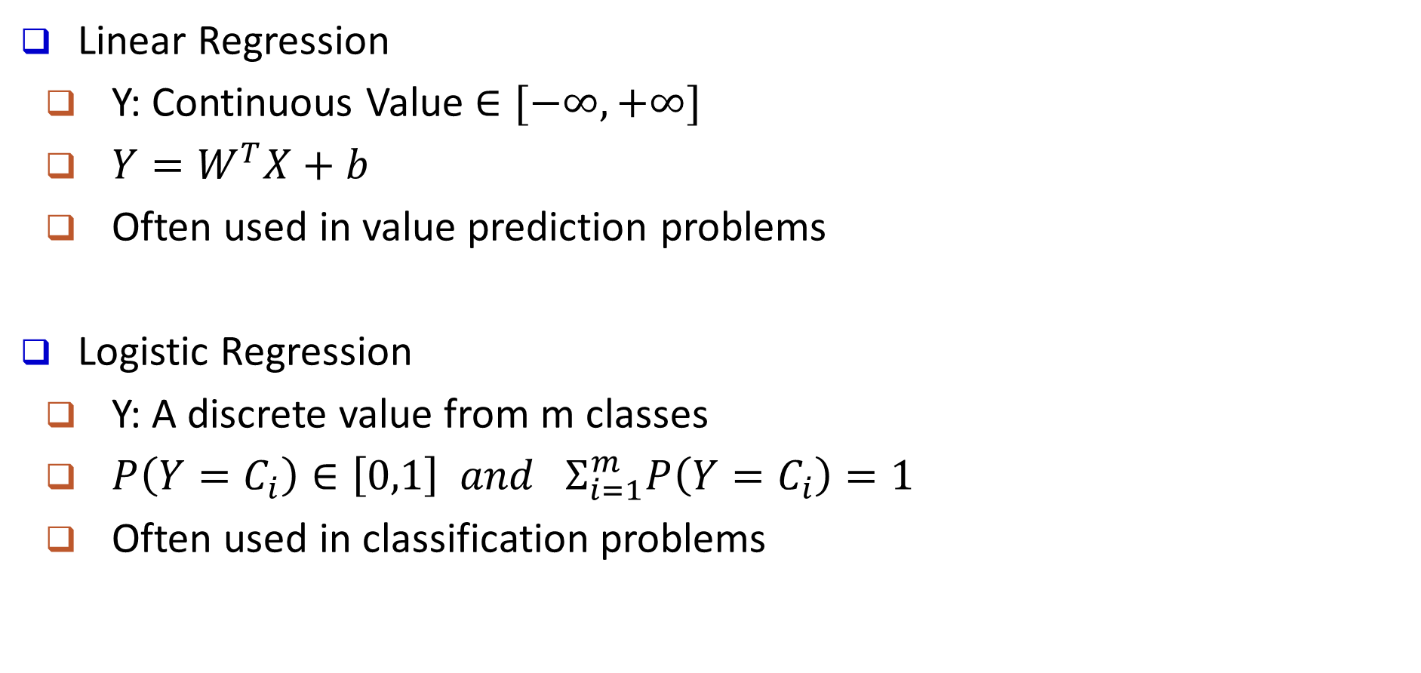
Linear Regression VS. Logistic Regression
Linear Regression
Y: Continuous Value $∈[−∞, +∞]$
$Y=W^{T}X+b$
Often used in value prediction problems
Logistic Regression
Y: A discrete value from m classes
$P\left(Y=C_{i}\right)∈\left[0,1\right] and Σ_{i=1}^{m}P\left(Y=C_{i}\right)=1$
Often used in classification problems

Slide 33
Dendrogram: Shows How Clusters are Merged
Dendrogram: Decompose a set of data objects into a tree of clusters by multi-level nested partitioning
A clustering of the data objects is obtained by cutting the dendrogram at the desired level, then each connected component forms a cluster
Hierarchical clustering generates a dendrogram (a hierarchy of clusters)

Slide 34
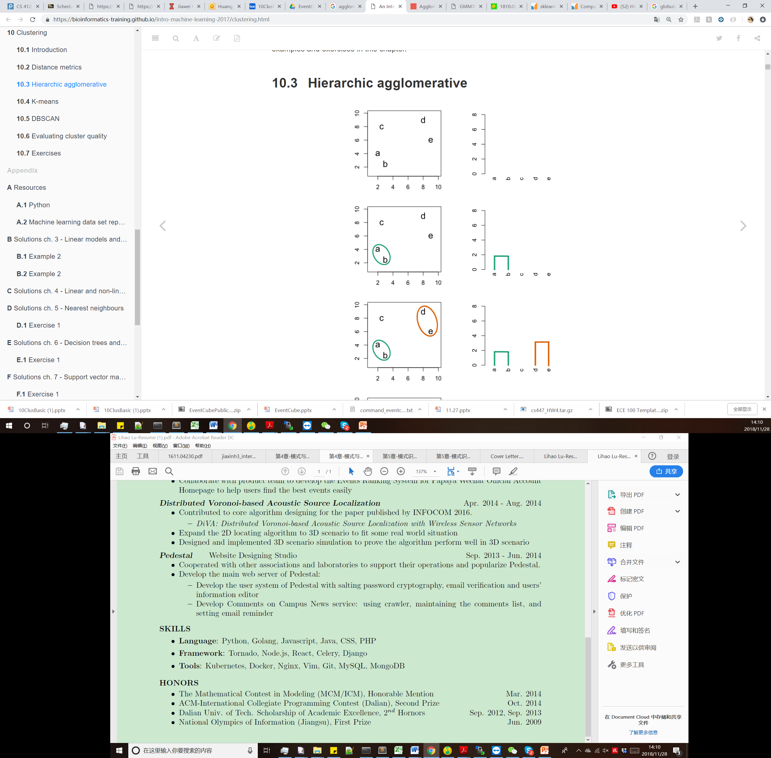
Agglomerative Clustering: Example
Distance Matrix
2-D Data points
a(2,4)
b(3,2)
c(2,8)
d(8,9)
e(9,6)
 | a | b | c | d | e
a | 0
b | 2.2 | 0
c | 4 | 6.1 | 0
d | 7.8 | 8.6 | 6.1 | 0
e | 7.3 | 7.2 | 7.3 | 3.2 | 0

Slide 35
Agglomerative Clustering: Example
Distance Matrix
2-D Data points
Update distance
Distance((a,b), c) = min(Distance(a,c), Distance(b,c)) = min(4, 6.1)=4
Distance((a,b), d) = min(Distance(a,d), Distance(b,d)) = min(7.8, 8.6)=7.8
Distance((a,b), e) = min(Distance(a,e), Distance(b,e)) = min(7.3, 7.2)=7.2
 | a,b | c | d | e
a,b | 0
c | 4 | 0
d | 7.8 | 6.1 | 0
e | 7.2 | 7.3 | 3.2 | 0
 | a | b | c | d | e
a | 0
b | 2.2 | 0
c | 4 | 6.1 | 0
d | 7.8 | 8.6 | 6.1 | 0
e | 7.3 | 7.2 | 7.3 | 3.2 | 0

Slide 36
Agglomerative Clustering: Example
Distance Matrix
2-D Data points
Update distance
Distance((d,e), (a,b)) = min(Distance(d,(a,b)), Distance(e,(a,b)) = 7.2
Distance((d,e), c) = min(Distance(d,c), Distance(e,c)) = 6.1
 | a,b | c | d,e
a,b | 0
c | 4 | 0
d,e | 7.2 | 6.1 | 0
 | a,b | c | d | e
a,b | 0
c | 4 | 0
d | 7.8 | 6.1 | 0
e | 7.2 | 7.3 | 3.2 | 0
 | a,b | c | d | e
a,b | 0
c | 4 | 0
d | 7.8 | 6.1 | 0
e | 7.2 | 7.3 | 3.2 | 0

Slide 37
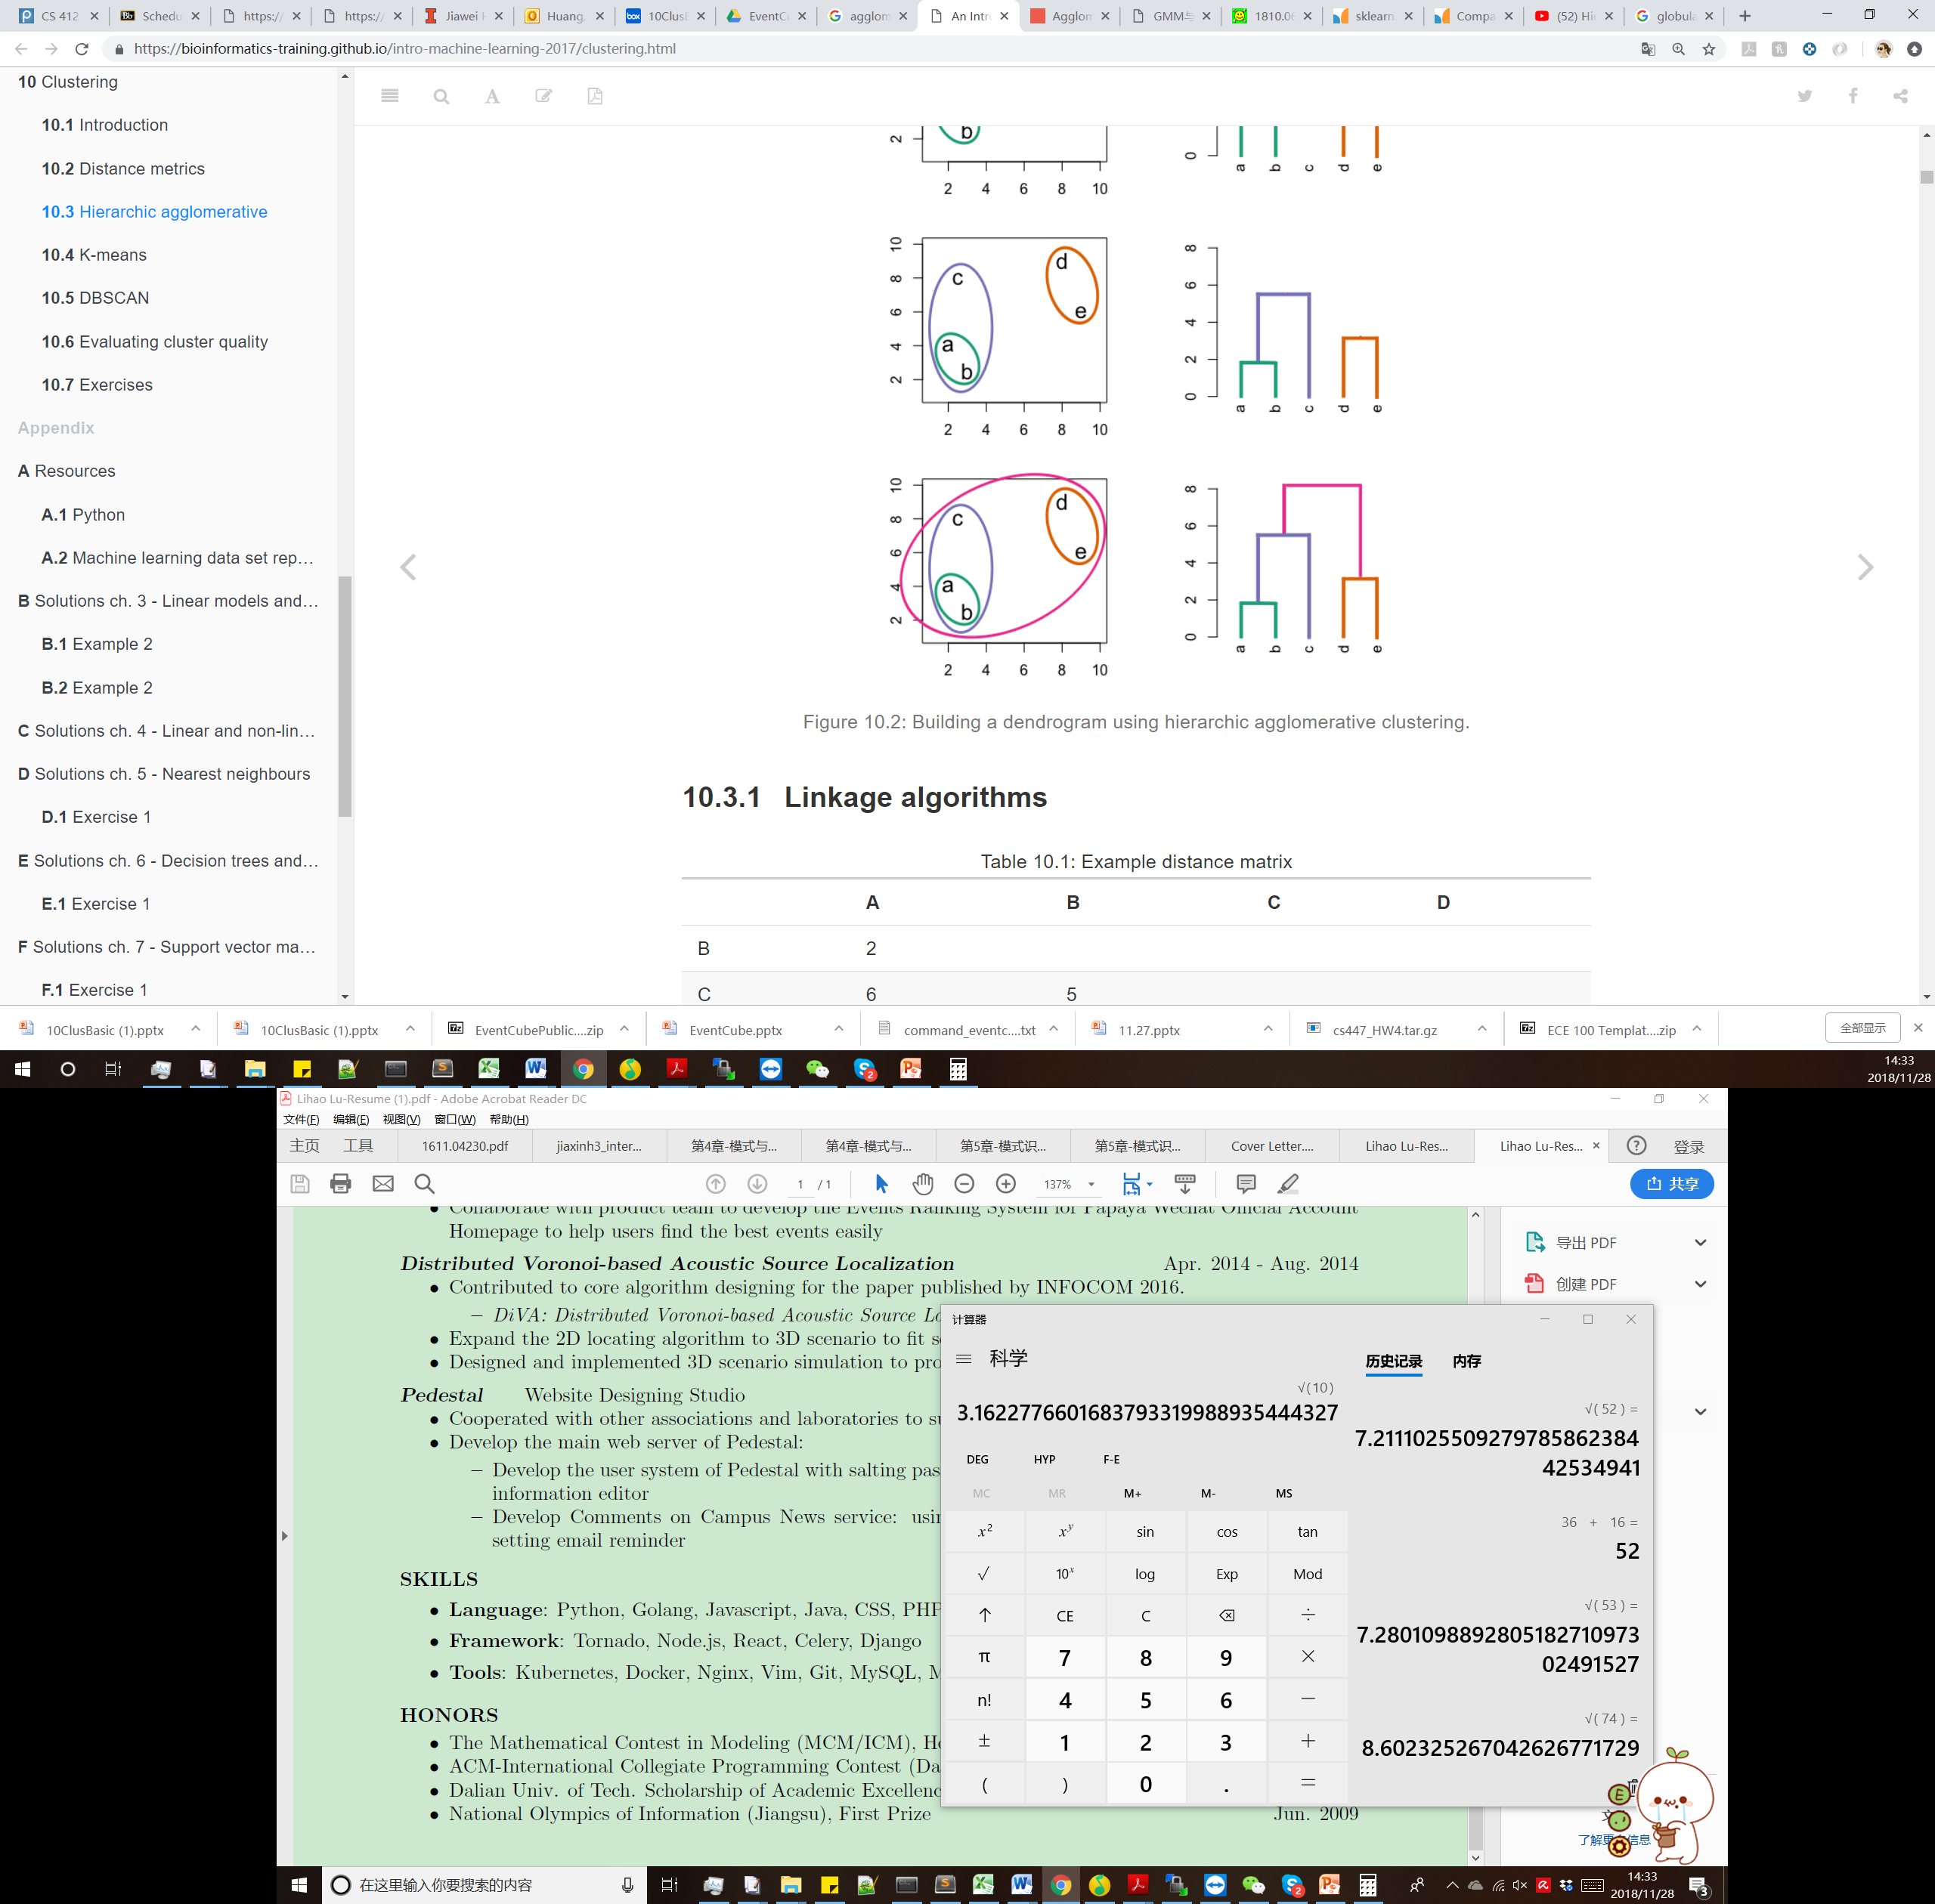
Agglomerative Clustering: Example
Distance Matrix
2-D Data points
Update distance
Distance((d,e), (c,(a,b)))= min(Distance((d,e),(a,b)), Distance((d,e),c) = 6.1
 | a,b | c | d,e
a,b | 0
c | 4 | 0
d,e | 7.2 | 6.1 | 0
 | a,b,c | d,e
a,b,c | 0
d,e | 6.1 | 0

Slide 38
Agglomerative Clustering: Example
Distance Matrix
2-D Data points
 | a,b,c,d,e
a,b,c,d,e | 0

Slide 39
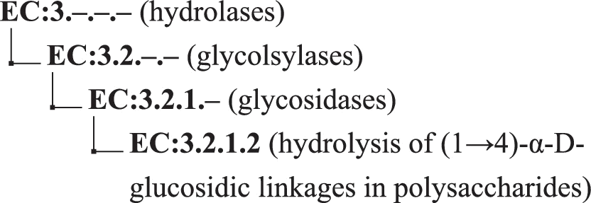
ML for Chemistry/Biochemistry
Example task 1: Enzyme function prediction
Data: amino acid sequence …RLPRSRFQRFWET…
Label: Enzyme Commission numbers
Task: given a sequence, predict its label

Slide 40
Modeling the Task
Data to feature
Raw amino acid sequence is hard to work with
Meaning of these sequences is more important
Idea: map the sequence data to vector space
Example: …RLPRSRFQRFWET… = [2.5, 3.4, 2.7, -1.8, …]
How: ESM embeddings
the models are trained on millions of natural protein sequences to understand the "language" of amino acids
Training Goal
Sequences with the same label should be close to each other
Sequences with different labels should be far away from each other

Slide 41
Modeling the Task
What we will get after training:
Z(X): a new embedding function for the enzyme function prediction task
How to inference
A new sequence s
Get embedding: Z(s)
Comparing with training data and predict a label: KNN (k-nearest neighbor)
1-NN: find the closest instance in training data. Use its label
k-NN: find the closest k instance in training data, use the majority label as result

Slide 42
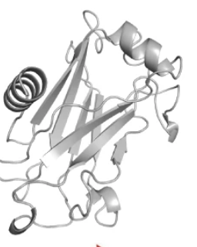
ML for Chemistry/Biochemistry
Example task 1: Enzyme function prediction
Data: amino acid sequence + 3D structure …RLPRSRFQRFWET… +
Label: Enzyme Commission numbers
Task: given an enzyme, predict its label

Slide 43
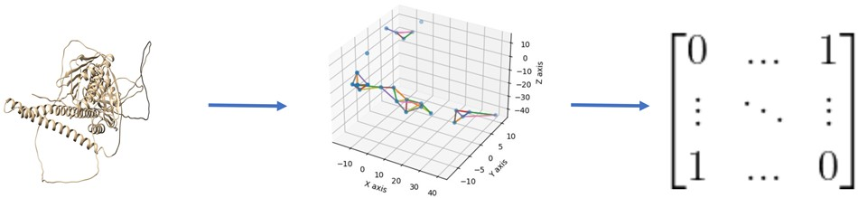
Modeling the Task
Data to feature
Sequence (same as before)
3D structure to graph
represented as a n × n adjacency matrix, where n is the number of residues in the protein
0 means no edge and 1 means there is an edge between two nodes
Bioinformatics, Volume 39, Issue Supplement_1, June 2023, Pages i318–i325, https://doi.org/10.1093/bioinformatics/btad208

Slide 44
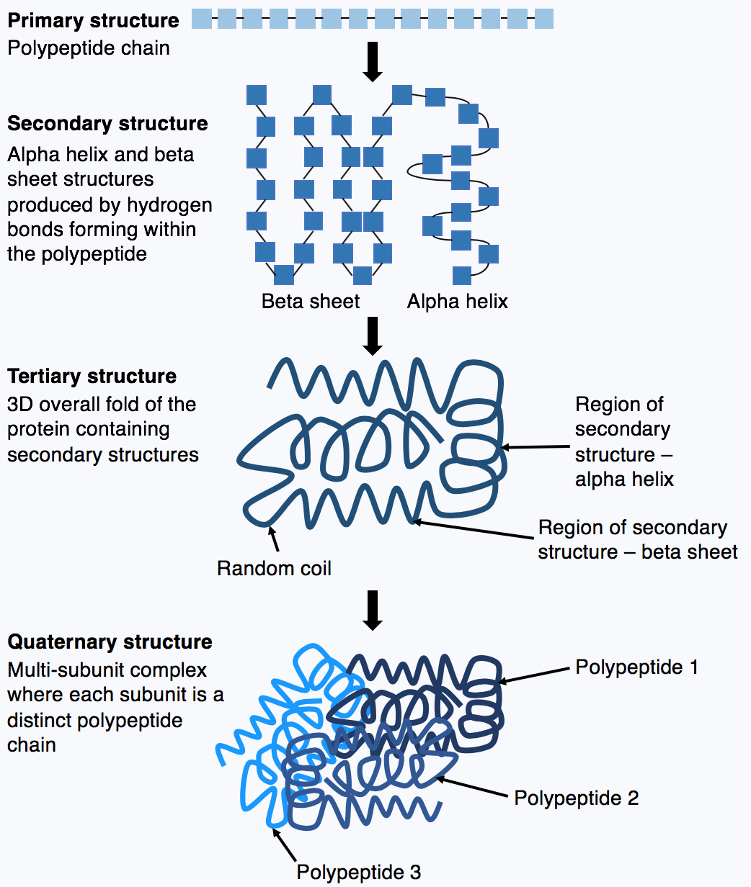
ML for Chemistry/Biochemistry
Example task 2: protein structure prediction
Alphafold
Data: amino acid sequence
Label: 3D structure (PDB and mmCIF file)
Task: given a sequence, predict the atomic coordinates
https://en.wikipedia.org/wiki/AlphaFold

Slide 45
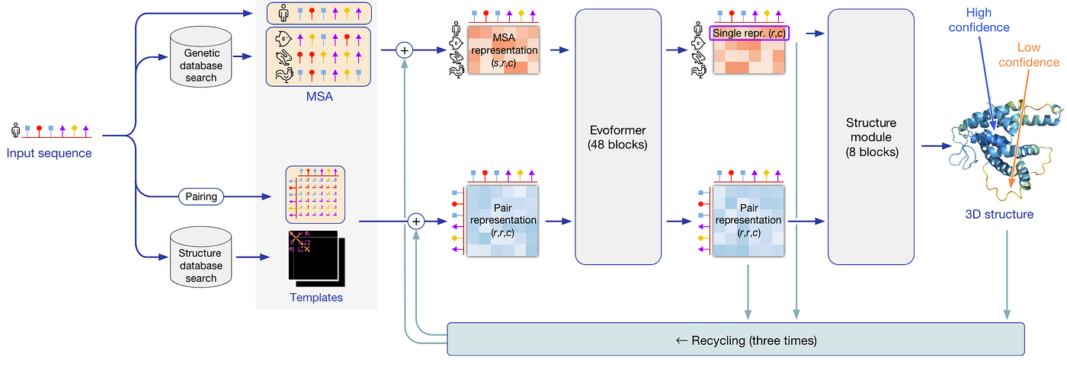
Alphafold 2
https://www.nature.com/articles/s41586-021-03819-2

Slide 46
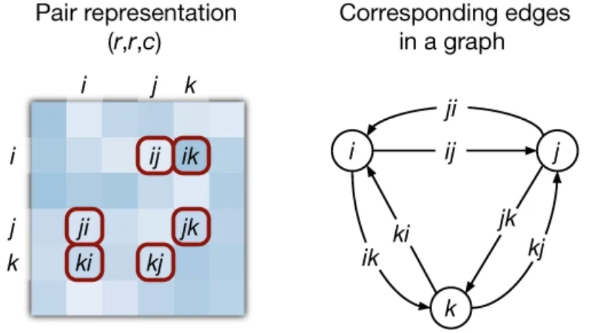
Modeling the Task
Data to feature
Key idea: graph
Residue-residue distance

